Slide 1
UK Net Zero - Review
August
2023
Will they reach their target by 2050?
Notes:
Net Zero refers to the legally binding strategy to turn the UK into a country that emits less greenhouse gases than they remove from the atmosphere. My presentation will be explaining what this means, why it is important, the steps the UK and other countries have taken already, evaluating the UKs progress and will end with answering the question of whether they will reach their target.
My objective today is first to bring greater awareness of this topic, help to explain why you should care and what actions you can take. Then end with providing you with hope for the future.

Slide 2
Background and Context
Greenhouse Gases include carbon dioxide, methane and nitrous oxide
Naturally produced by the planet and from human activities
Earth would be approximately 33 degrees cooler without them!
Global Warming is the rise in average temperature since the industrial revolution (18th Century)
Climate Change is the consequence of rising temperatures in the oceans
Created a negative multiplier effect as seen by melting ice caps
Non renewables are resources like coal, gas, oil and nuclear that is in limited supply
Renewables includes the sun, wind, hydropower and biofuels

Slide 3
Action Taken
Climate acts and the effect on the planet
United Nations (UN) Climate Change agreements:
Kyoto (2005) decrease at least 5% below 1990 levels
Paris (2015) decrease global warming by 1.5 – 2 degrees
Examples of climate change:
Syria mass migration
Food quality and supply
Extreme weather events
Jakarta underwater by 2050
Notes:
Growing up in the 21st century, the threats of climate change was widely known but there was a lack of urgency, investment and bravery from governments and Multinational corporation to limit how much the planet was warming up. It was only after the Kyoto protocol was put into action in 2005 after 7-8 years of negotiations that action started to occur. Part of United Nations, It aimed to reduce the industrialized countries' overall emissions of carbon dioxide and other greenhouse gases by at least 5 per cent below the 1990 levels in the commitment period of 2008 to 2012. How many countries signed it? 55. USA never joined, Canada left. Mainly European countries and Australia.
The new agreement was created in 2015 called the “Paris Treaty”. First time included a specific goal for limiting global warming to significantly below 2°C, with a target of preferably 1.5°C compared to the pre-industrial level of 1750. The Paris Agreement states that all signatories – not just industrial countries as in the case of the Kyoto Protocol – must commit to binding targets for CO₂ reduction, a steadily increasing ambition and the net-zero target. How many countries signed it? 193. 98% of emissions
What does those temperature means for the planet?

Slide 4
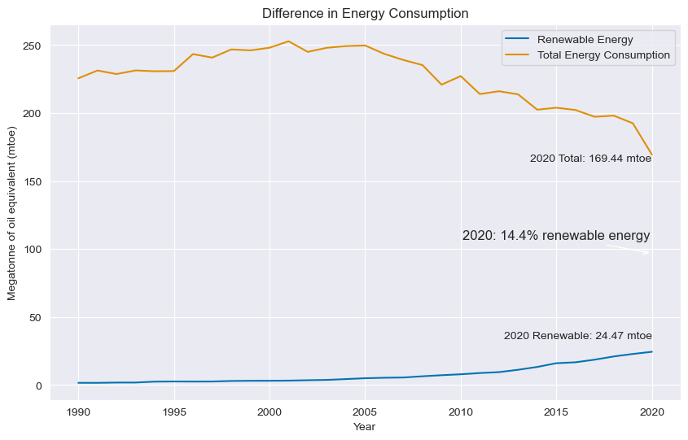
A closer look at the UK
France and Japan have reached 20%
Not fully electrified our systems
UK has a moral responsibility to lead the transition
Notes:
###Mtoe(megatonne of oil equivalent) ##For context 1 mtoe = 42 petajoules (42 x 10^15 J) ## 1 pj = 0.2778 tWh ##42 pj = 11.67 tWh
So 1 mtoe = 11.67tWh
##To compare to UK of 15%, the electric share energy is 20% with france and japan. ##We haven't fully electricfied our systems yet which makes it even more important for them to lead the transition

Slide 5
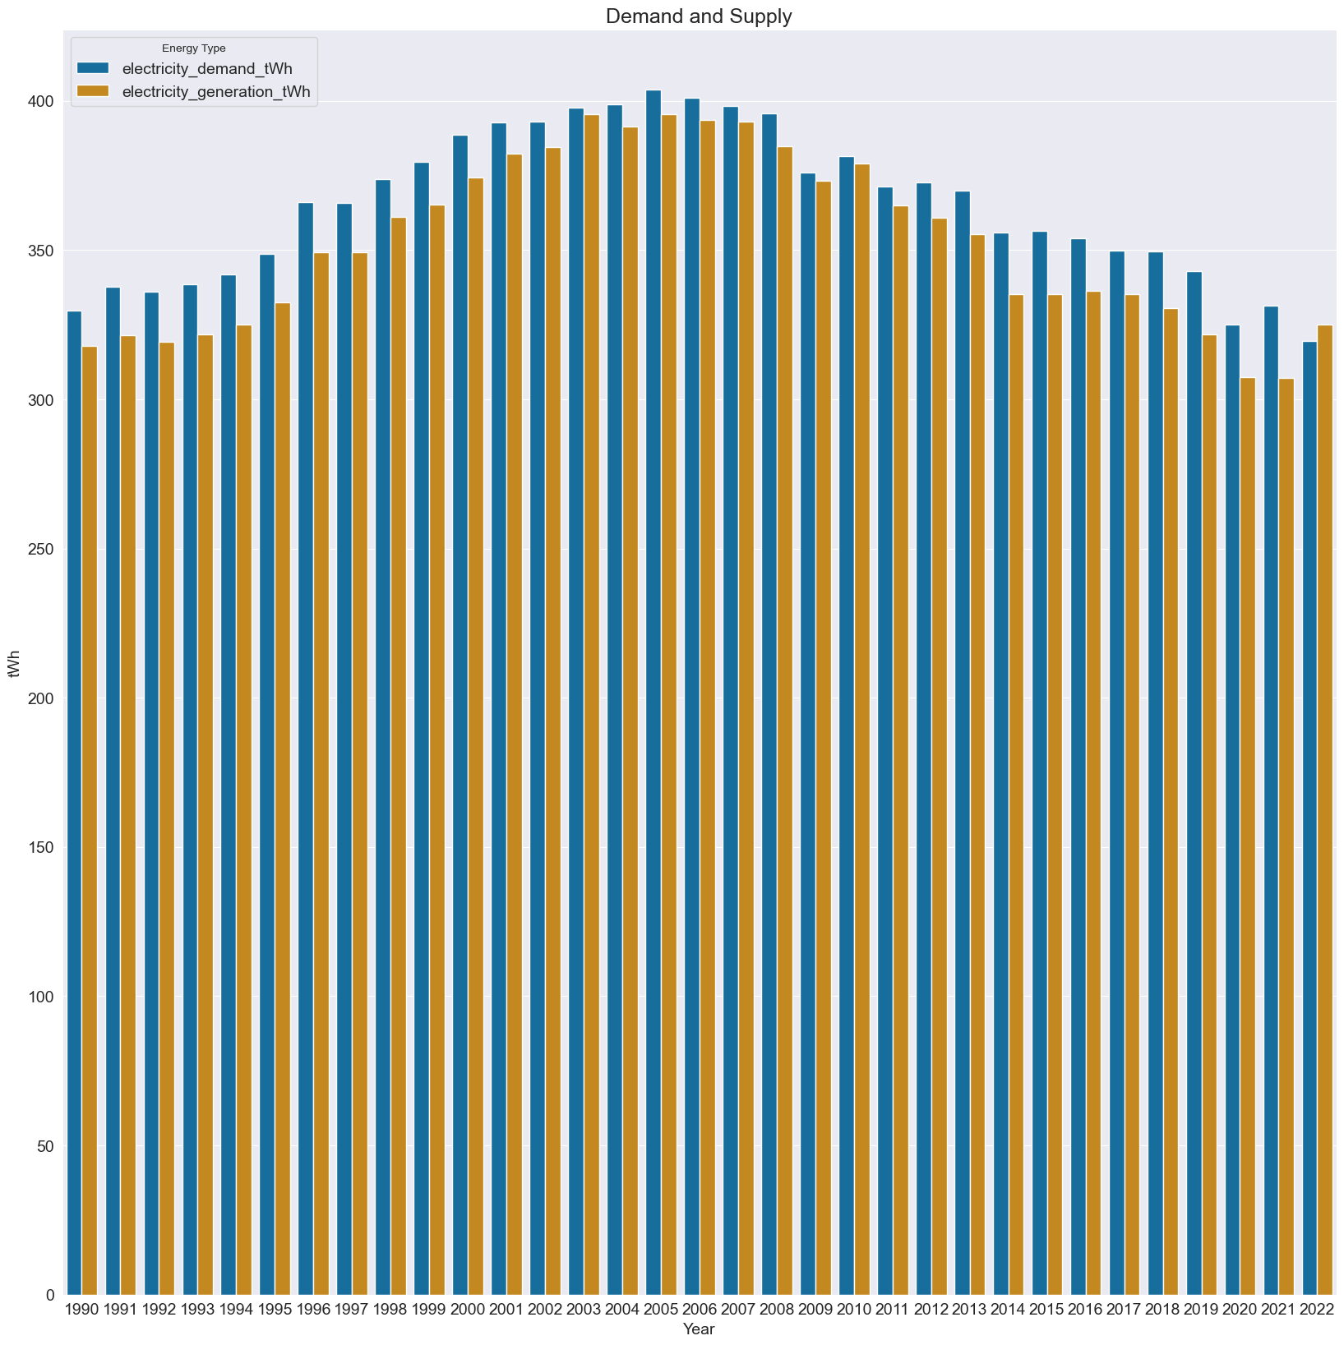
UK Electricity
Electricity is the major tool we have to fight climate change compared to other options.
The direct use of electricity doesn’t emit any greenhouse gases! Wonderful (problem solved)
Unfortunately the generation of electricity in the past and present occurred/s through the combustion of coal, gas and oil.
In the last few decades, major strives have been taken to create renewable electricity through solar panels, wind turbines, hydropower(tidal) and biomass(combustion of plants, trees).
Zero carbon generation by 2035
Notes:
How much of the UK’s energy is renewable?
With the UK aiming to reach net zero by 2050, a crucial part of the strategy is to transition to an electricity system with 100% zero-carbon generation and much of this is expected to come from renewable energy in 2035.

Slide 6
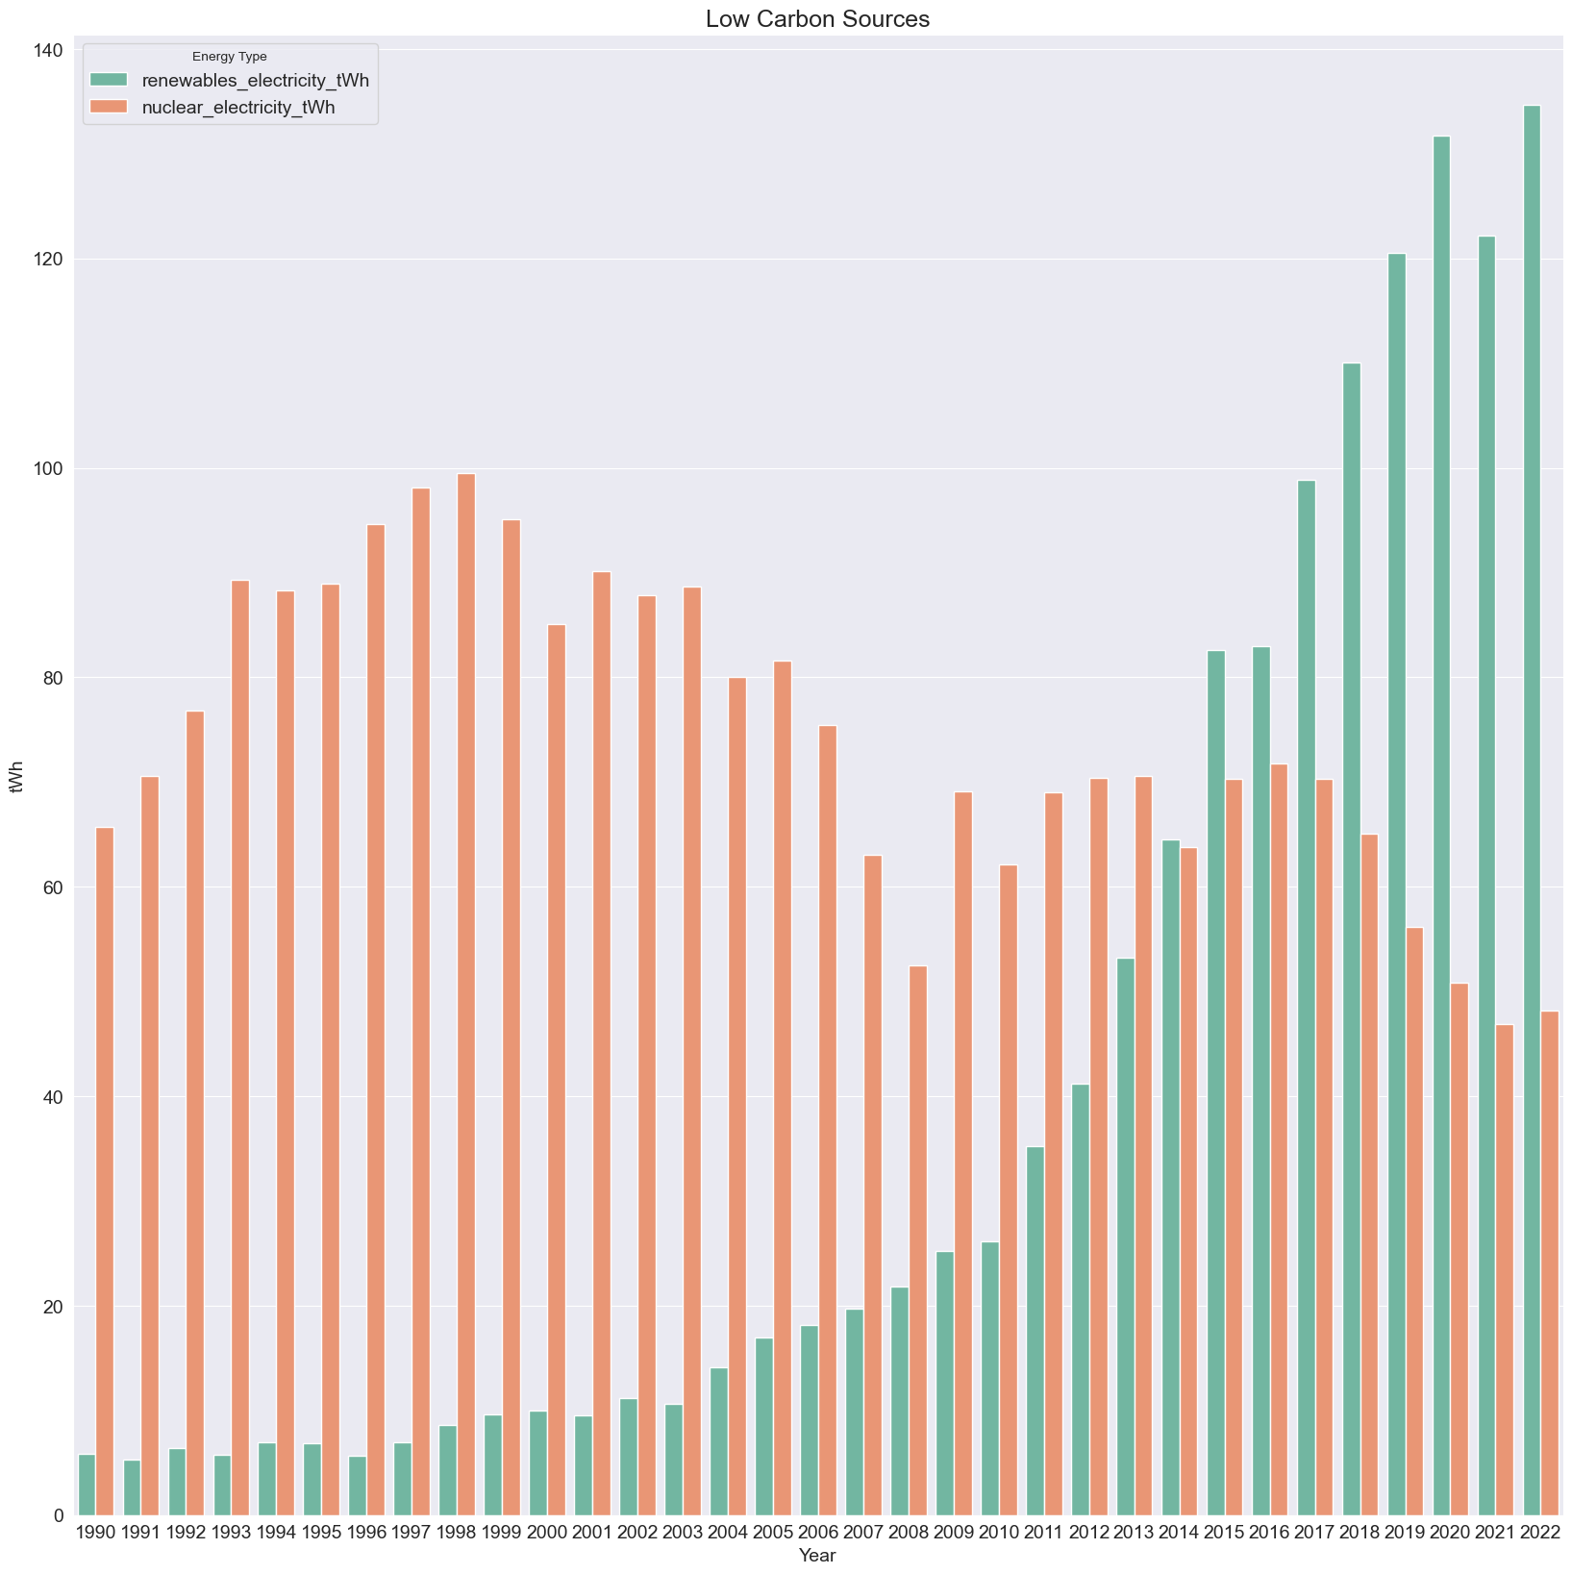
Breakdown of UK electricity generation (Low emissions)
The UK currently has five operational nuclear power plants, owned by EDF
8 new plants are planned to open
25% of electricity demand by 2050
Stigma attached to nuclear from historical disasters e.g. Chernobyl(1986) and Fukushima(2011)

Slide 7
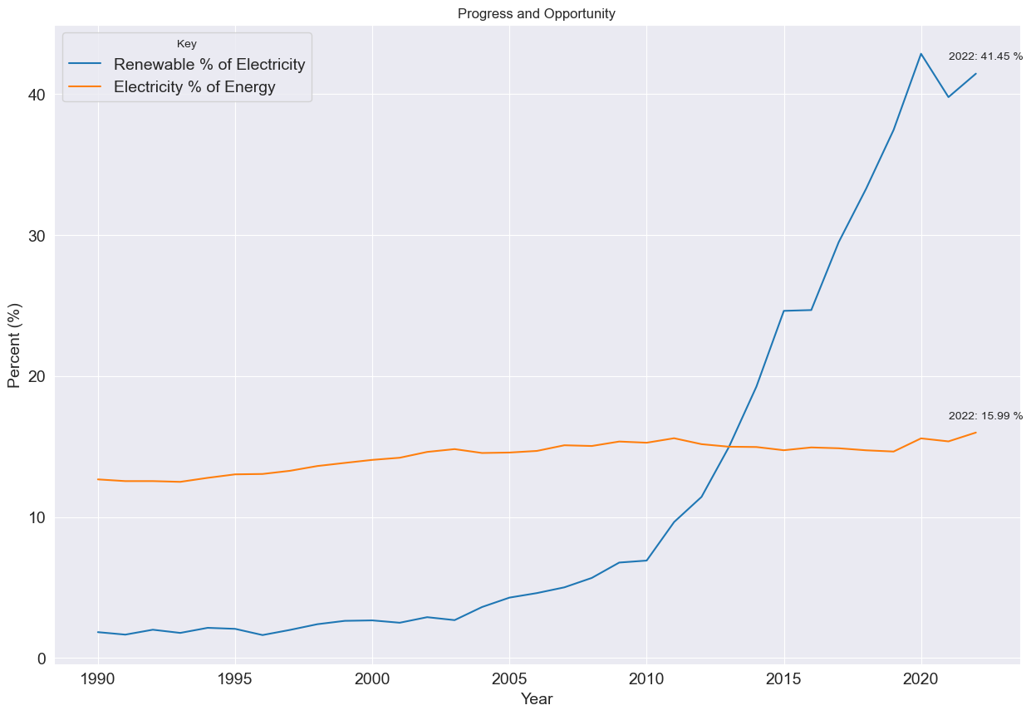
UK Renewables
Why is the rate not improving at the same rate?

Slide 8
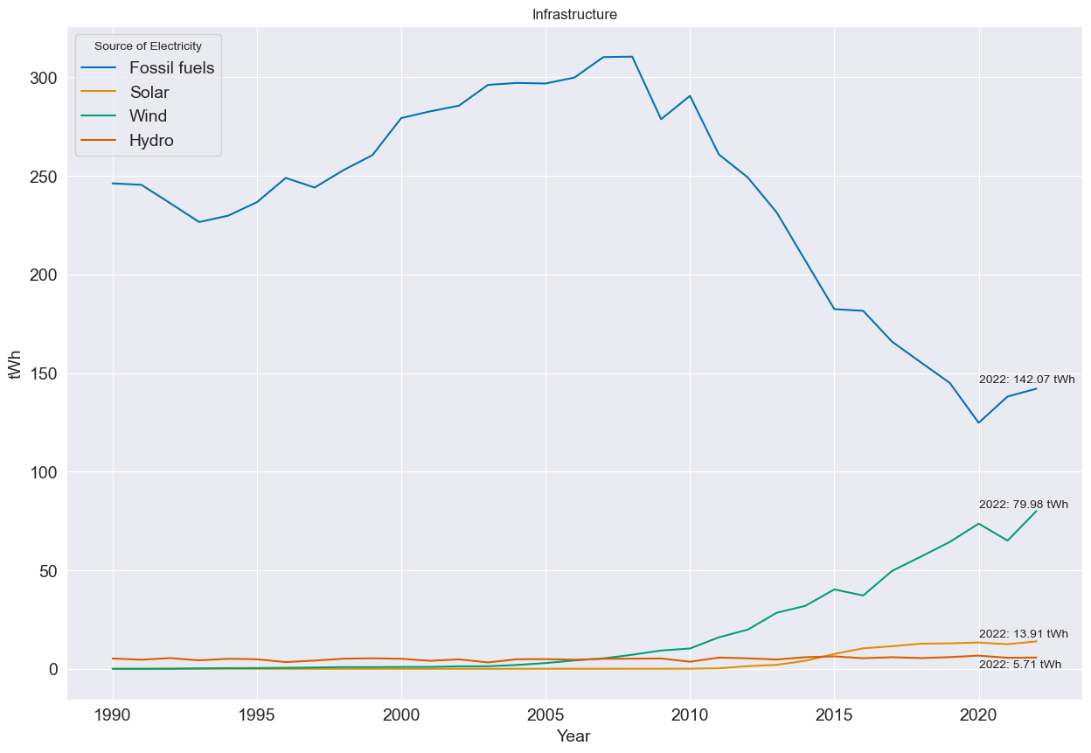
UK Renewables

Slide 9
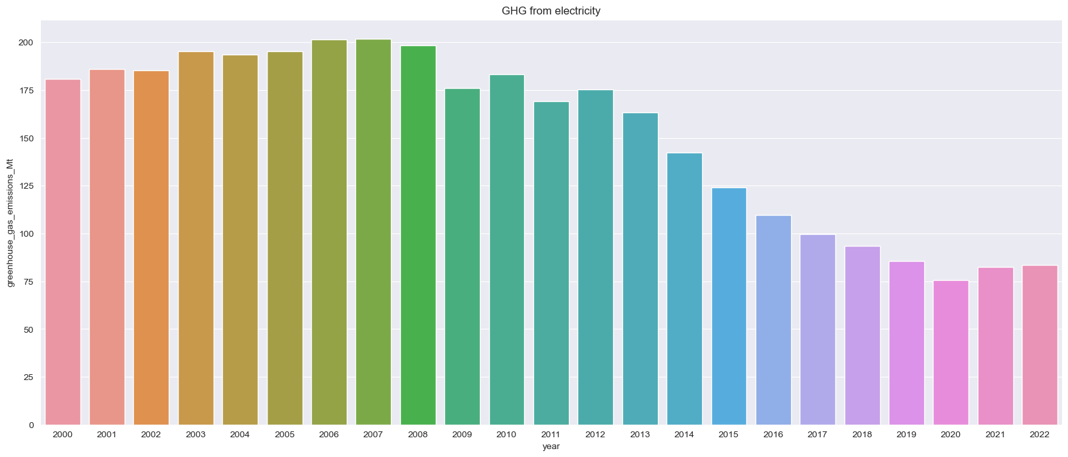
UK Greenhouse Gases emissions

Slide 10
Critical look at the UK
Infrastructure issues:
Britons paying hundreds of millions to turn off wind turbines as network can't handle the power they make on the windiest days | Climate News | Sky News
Renewable energy projects worth billions stuck on hold - BBC News
Innovative solutions:
Over 65% of homes in Britain can work for solar panels | Ecotricity – Mini power stations and quicker to transition
Revolutionary new Swiss 'water battery' will be one of Europe's main renewable sources of energy | Euronews – Two large pools of water at different heights and flow rotates the turbine
The cooling effect of trees and green spaces in cities | Friends of the Earth – Natural carbon sinks and shade cover reduces temperatures, 2803 excess deaths during summer 2022
Notes:
Making the energy our homes need on our own rooftops will reduce our dependence on energy companies and the global fossil fuel market. Excess energy can even be sold back to the grid. Our homes can be like mini power stations.
And speed is another big win from a rooftop revolution in solar - the queues to connect large scale generators to the grid right now are 10 to 15 years long, it’s a major constraint for big generation but not for micro - each house would hold just 5kW of solar capacity, fitting in more easily with the existing grid.

Slide 11
Will they meet their target?
From my investigation I have reached the conclusion that the answer is NO.
The UK Climate Change Committee in their last review (2022) found delivery of programmes lacking compared to their ambitious targets.
The High Court found the UK government in breach of the Climate Change Act in 2022
Positives have been renewables and take up of electric cars. The negatives are focused on energy efficiency in homes, carbon capture, agriculture and airlines.
What can be done to change this?
Radical change rather than a conservative approach
Public ownership of utilities
Vote with your wallets
Spread the word
Don’t become a NIMBY

Slide 12
THANK YOU!
Created by Karan Ruprah
Any Questions?

